Slide 1
Cyber Operations
Cyber Club

Slide 2

Agenda
1. Raymond James and CNY Hackathon talk
2. Review
3. SOC
4. SOC Tools
5. SOC Data
6. Demo

Slide 3
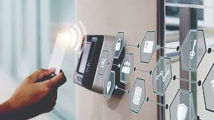
Access Control Review
A security process that regulates who can view or use resources in a system.
You can apply it by setting permissions through passwords, mfa, rbac, etc.
It is most commonly seen in systems, networks, and physical environments.

Slide 4
Cyber Stats
The average cost of a data breach is $3.86 million globally.
In the US, the average cost of a data breach is $8.64 million.
The average time it takes an organization to identify and contain a breach is 280 days.

Slide 5
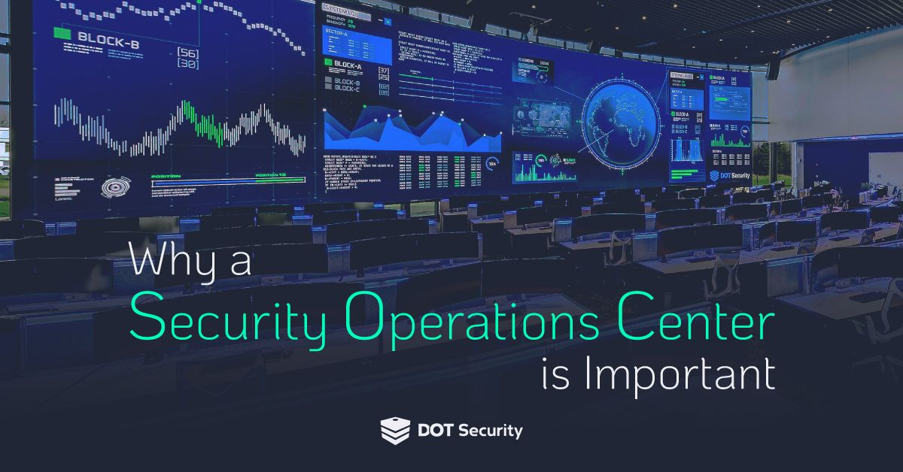
What is SOC
Security Operations Center - one layer of many used to prevent threat actors
Continuously watches over network activity looking for suspicious behavior
Threat monitoring, incident detection and response, etc.

Slide 6
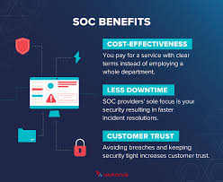
SOC Functions
Collection
Detection
Triage
Investigation
Incident Response

Slide 7
Roles within SOC
SOC Analysts - have specified tasks but work in tandem with various of other professionals
SOC managers - Direct a group SOC analysts to be observe and tackle a possible incident
CISO (Chief Information Security Officer) - oversee all functions within the SOC

Slide 8
Supporting SOC Roles
Other roles which work closely within SOC environments
- Threat Intelligence / Threat Hunters
- Forensics Investigators
- Pen Testing/Red Teaming
- Vuln Management
- Security engineers
- Reverse Malware Engineers

Slide 9
Tools of SOC
Core tools
1. SIEM
2. Threat Intelligence Platform
3. Incident Management System
SOAR, IDS, Firewalls, GRC

Slide 10
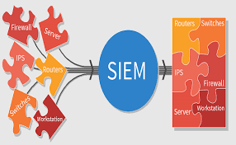
What is a SIEM
The eyes of the network - without it, the IT team is blind to their own environment
Revieces and parses logs, can enrich or correlate data gathered

Slide 11
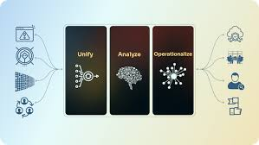
What is Threat Intelligence Platform
Gathers and analyzes data on current and emerging cyber threats
Feeds the Incident Management System real time threat data
Enhances security against known threats
Notes:
the threat intelligence platform will likely be taking in info from external threat intel vendors, as well as any information produced within the threat intel team or the SOC fed back from actual incidents

Slide 12
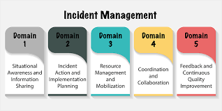
What is Incident Management System
Helps track, manage, and resolve any incidents in a structured and timely manner
Information is passed from the SIEM and enhanced to allow for direct analysis of active incidents

Slide 13
Important Data Collected
- Endpoint Data
Information found at the device which ask for and give information
- Network Data
Information as it travel across a network, aka data in transit
Notes:
These two sets of data are important because they provide complete visibility.
Endpoints show what is happening on devices while Networks show what is happening in between those devices.

Slide 14
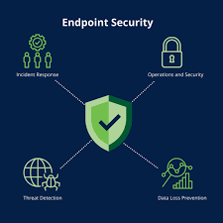
Endpoint Data
Process of collecting information of a system in which details about key information points are, typically stored in logs, are then centralized to a SIEM
- Program Executions
- Script Execution
- Authentication Logs
- Config Monitoring

Slide 15
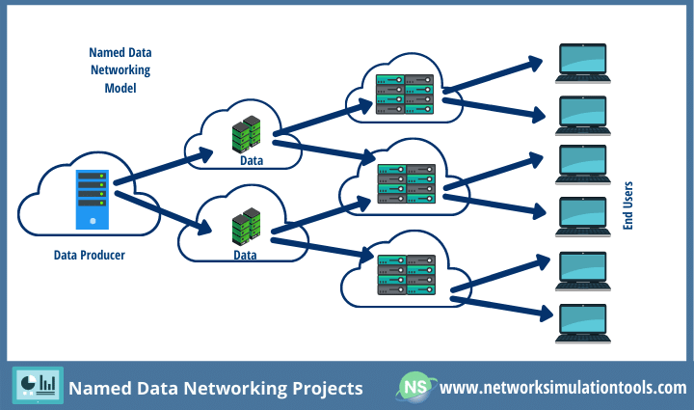
Networking Data
Flow records - layer 3 and 4
Transactional records - layer 7
Full packet capture
Notes:
Flow records contain information of which is related to OSI layer 3 and 4 (TCP/IP) and provides the follow types of data at a glance
• Traffic volume / bandwidth
• Start, stop, and length of connections
• Conversation source and destination IPs
• Source and destination ports
• Protocols assumed by ports
Transactional records looks at the entire packet typcilly inspected by a NGFW which has the potential to uncover indicators of attack or compromise when looking at the packet’s data
Full packet capture is exactly what we did during the wireshark lab. Every bit it record and is able to be replayed allowed for security analysts to be able to view full conversations and carving out files send during recorded capture

Slide 16
Frameworks
These are the guides which are called and used on a daily basis to allow for full functionality of SOC with best practices
- The Lockheed Martin Cyber Kill Chain
- Incident Response Cycle (NIST SP800-61r2)
- David Bianco’s Pyramid of Pain
- The Diamond Model of Intrusion Analysis
- MITRE ATT&CK – list of attacker tactics, tech
Notes:
Lockheed Martin Cyber Kill Chain: A framework that describes the stages of a cyberattack from reconnaissance to actions on objectives, helping defenders identify and disrupt attacker activity.
Incident Response Cycle (NIST SP 800-61r2): A structured process for managing and responding to cybersecurity incidents, consisting of preparation, detection and analysis, containment, eradication and recovery, and post-incident activity.
David Bianco’s Pyramid of Pain: A model illustrating that as defenders force attackers to change more difficult indicators (like TTPs rather than hashes), they impose greater “pain” and disruption on adversaries.
The Diamond Model of Intrusion Analysis: An analytical framework that represents intrusions through relationships among four core features — adversary, capability, infrastructure, and victim — to understand and counter threats.
MITRE ATT&CK: A comprehensive, globally accessible knowledge base of adversary tactics, techniques, and procedures (TTPs) mapped across the stages of an attack to aid in detection, analysis, and defense.

Slide 17
Demo
Either
1. Making a SIEM from scratch
2. Testing SIEM via RangeForce or OVA
3. Exploring one of the provided tools as a Club
-> jumping into the deep end and trying to make it work out
All information can be found on github for any of the potential demos

